Slide 1
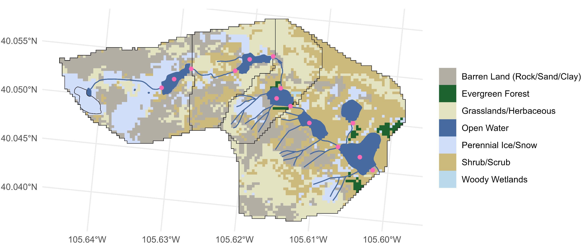
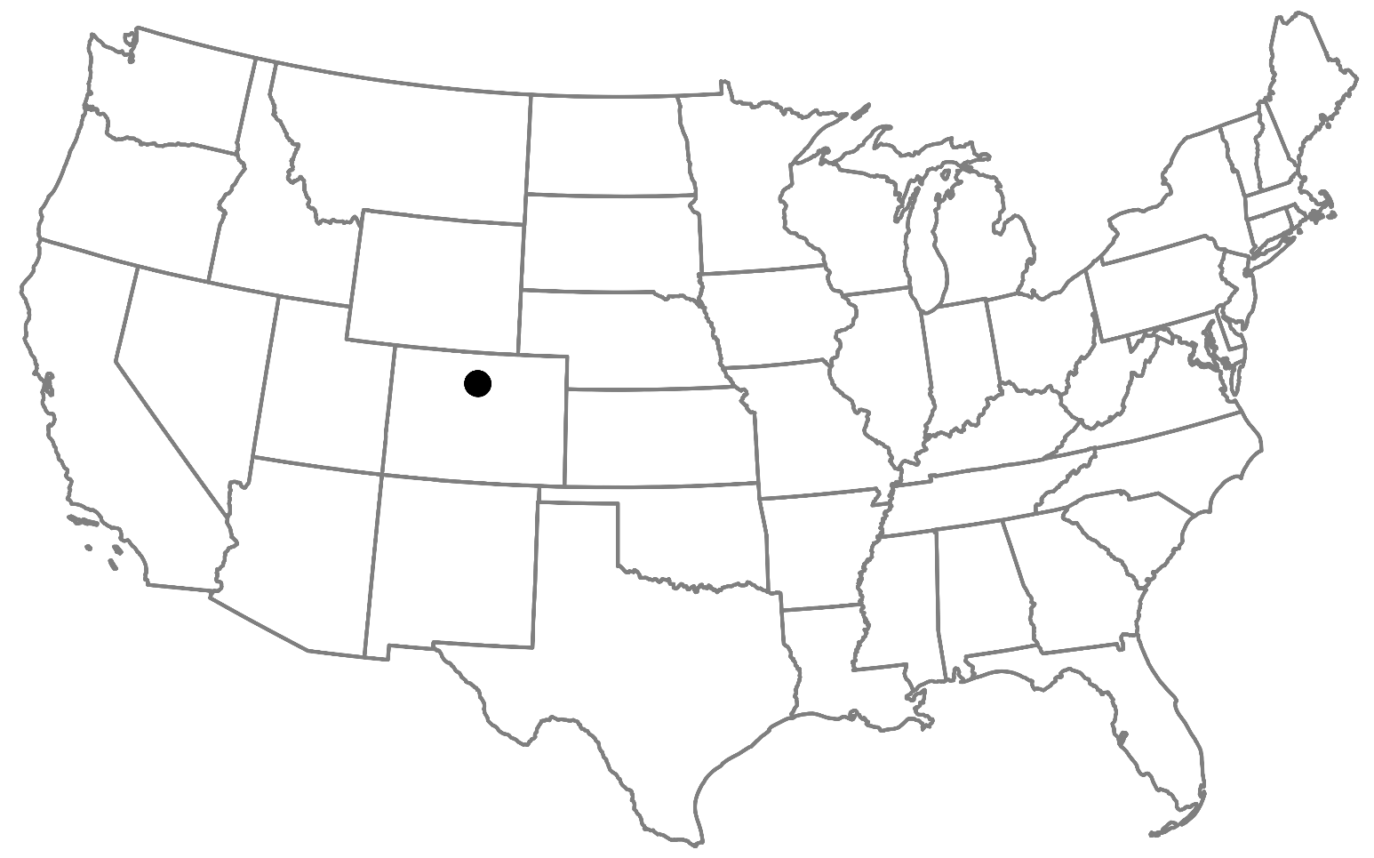
GL4
GL3
Total drainage area: 5.5 km²
Elevation: 3748 m at Arikaree Glacier to 3352 m at Albion outlet
GL5
ALB
27.3%
1.25%
23.8%
Arikaree Glacier
5.17%
14.8%
27.6%
0.07%
Flow direction

Slide 2
GL4
GL3
Total drainage area: 5.5 km²
Elevation: 3748 m at Arikaree Glacier to 3352 m at Albion outlet
GL5
5
6
ALB
3
4
2
27.3%
0
1
7
8
9
1.25%
10
23.8%
0
Arikaree Glacier
5.17%
11
12
14.8%
13
27.6%
0.07%
Flow direction

Slide 3
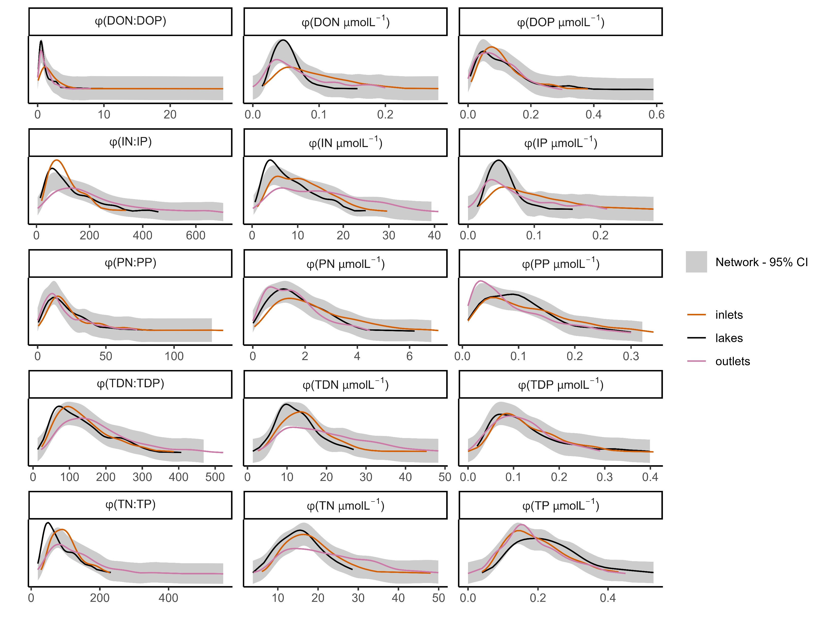
a, b, b
a, b, c
a, b, ab
a, ab, c
a, b, c
a, b, c
a, ab, b
a, b, b
a, a, b
a, a, b
a, b, c
a, a, a
a, b, c
a, b, c
a, b, a

Slide 4
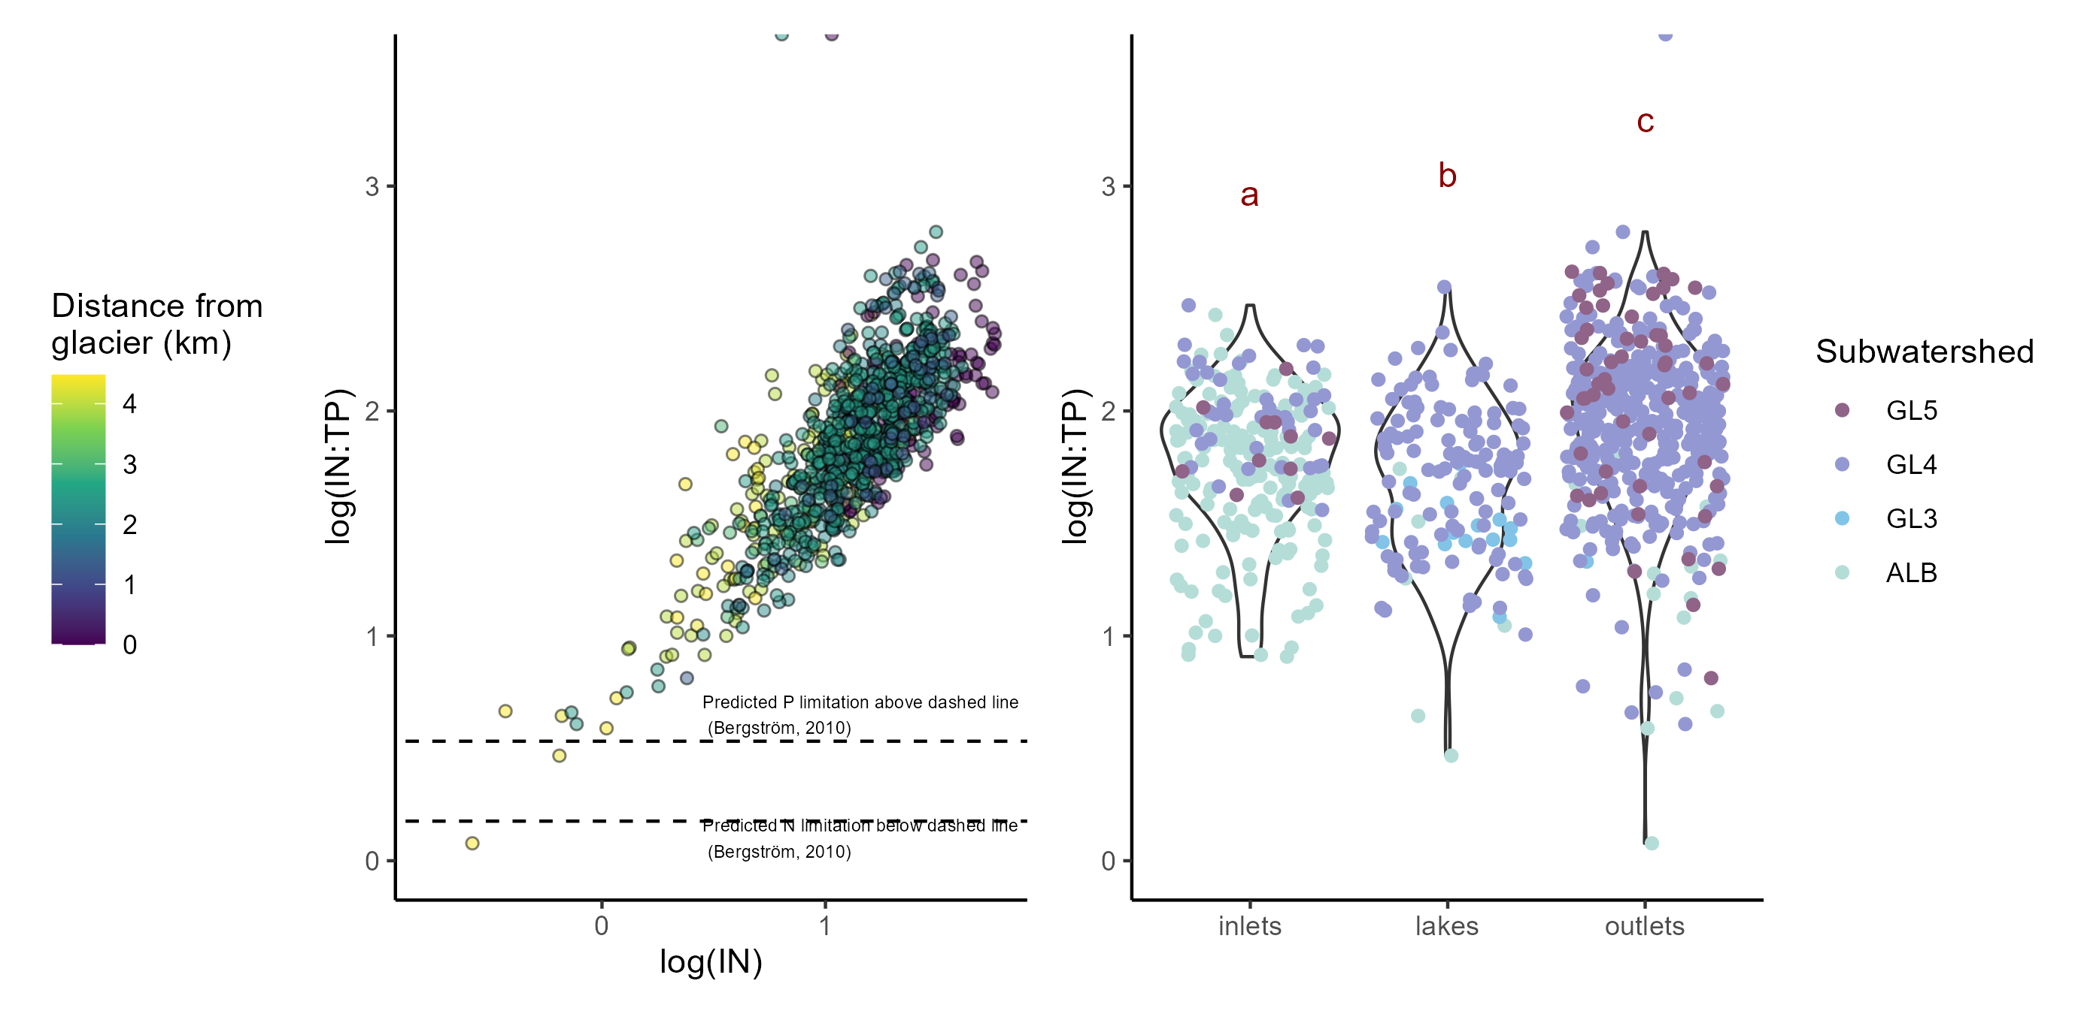
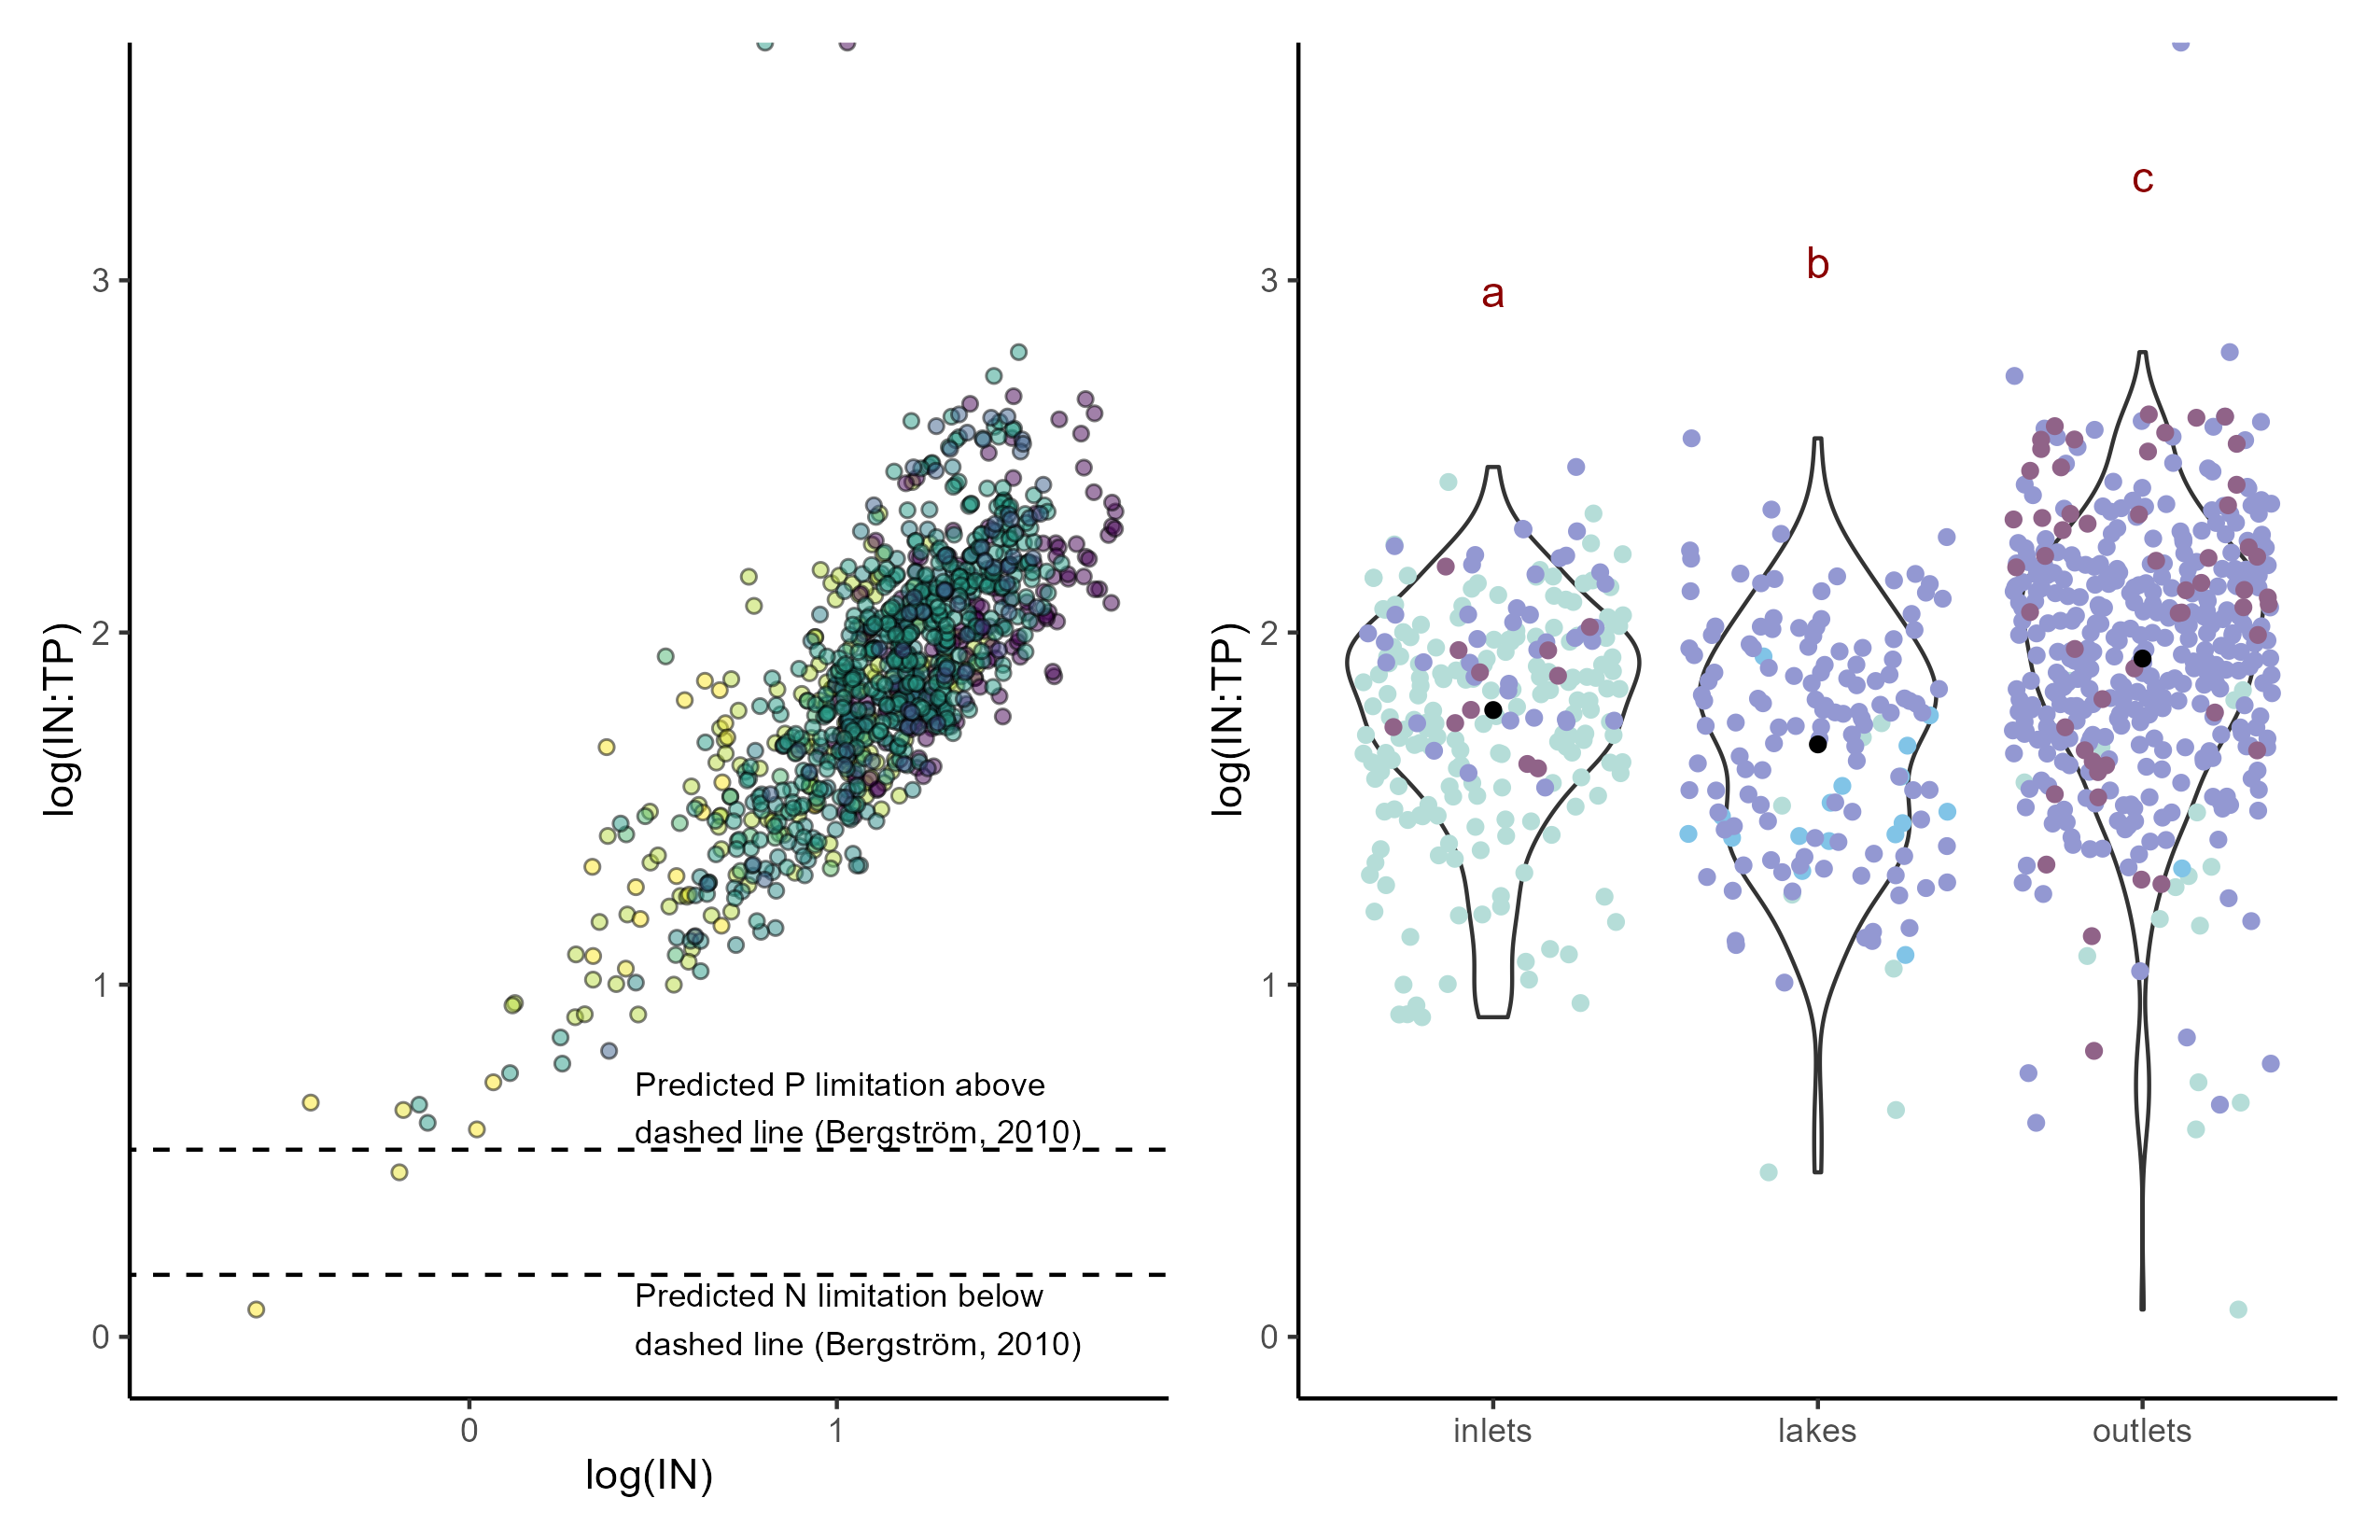
a)
b)

Slide 5
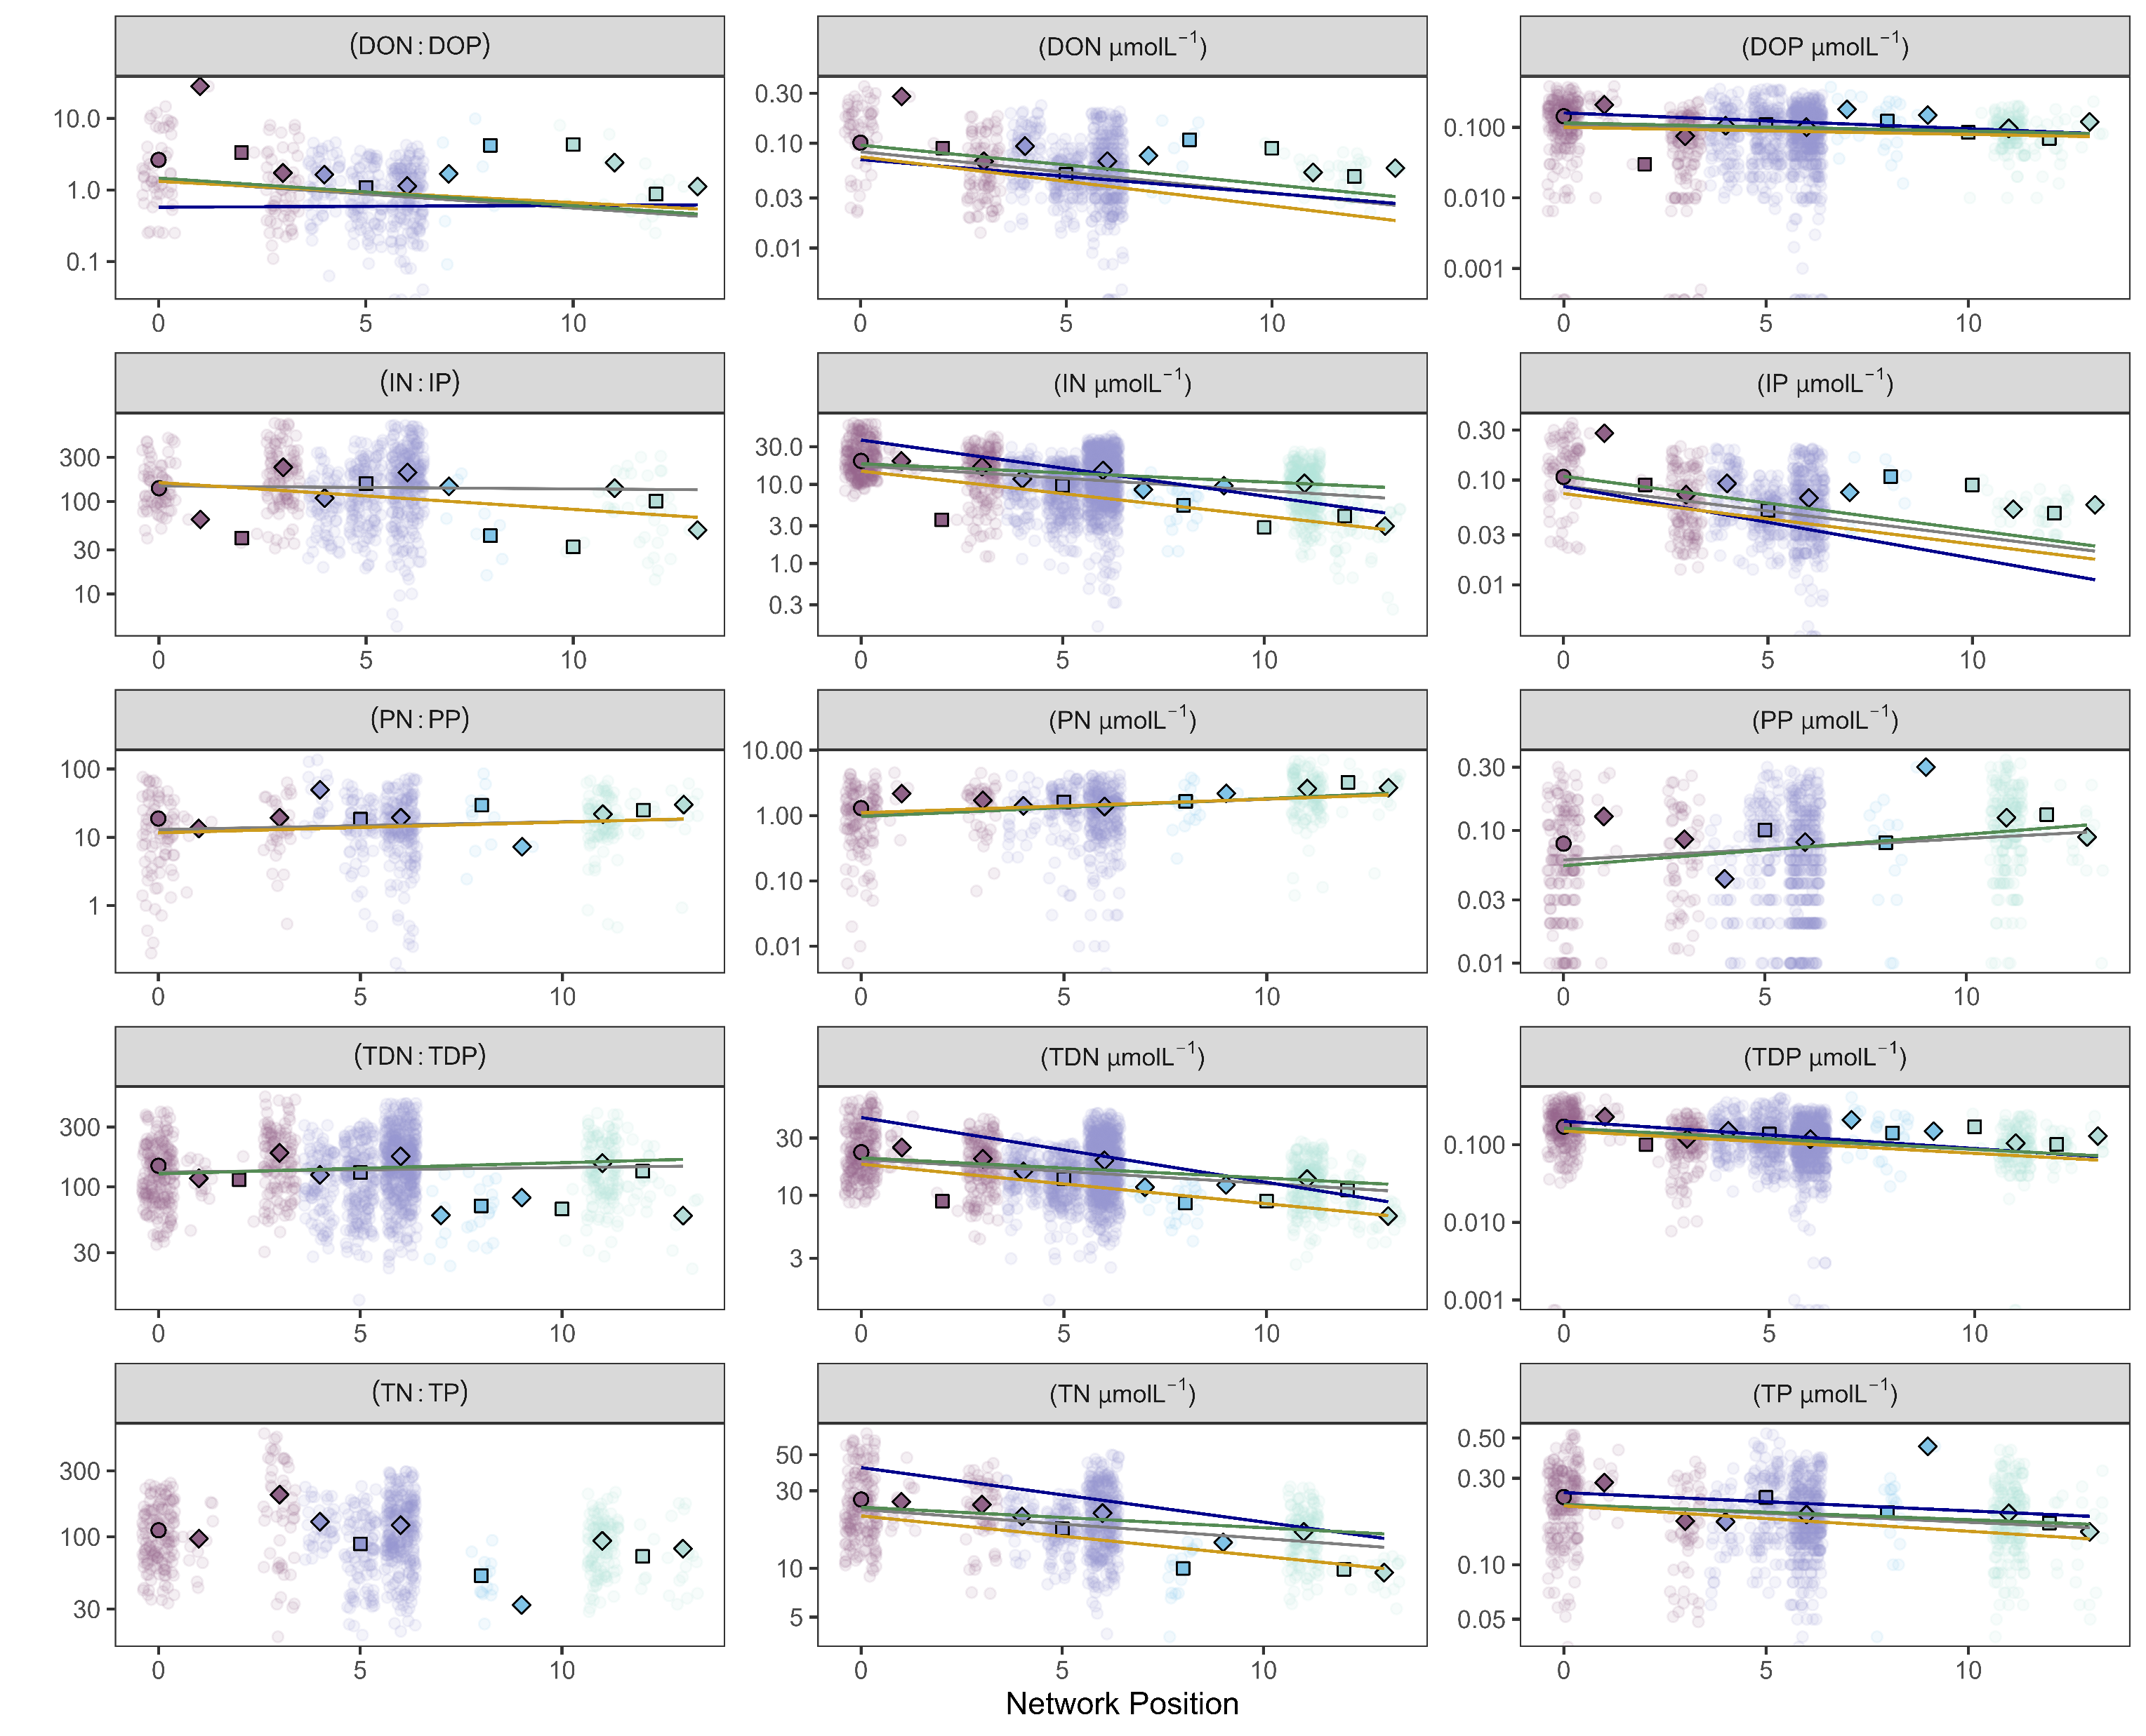
Seasonal slope
global
winter
snowmelt runoff
summer
glacier
lake
stream

Slide 6
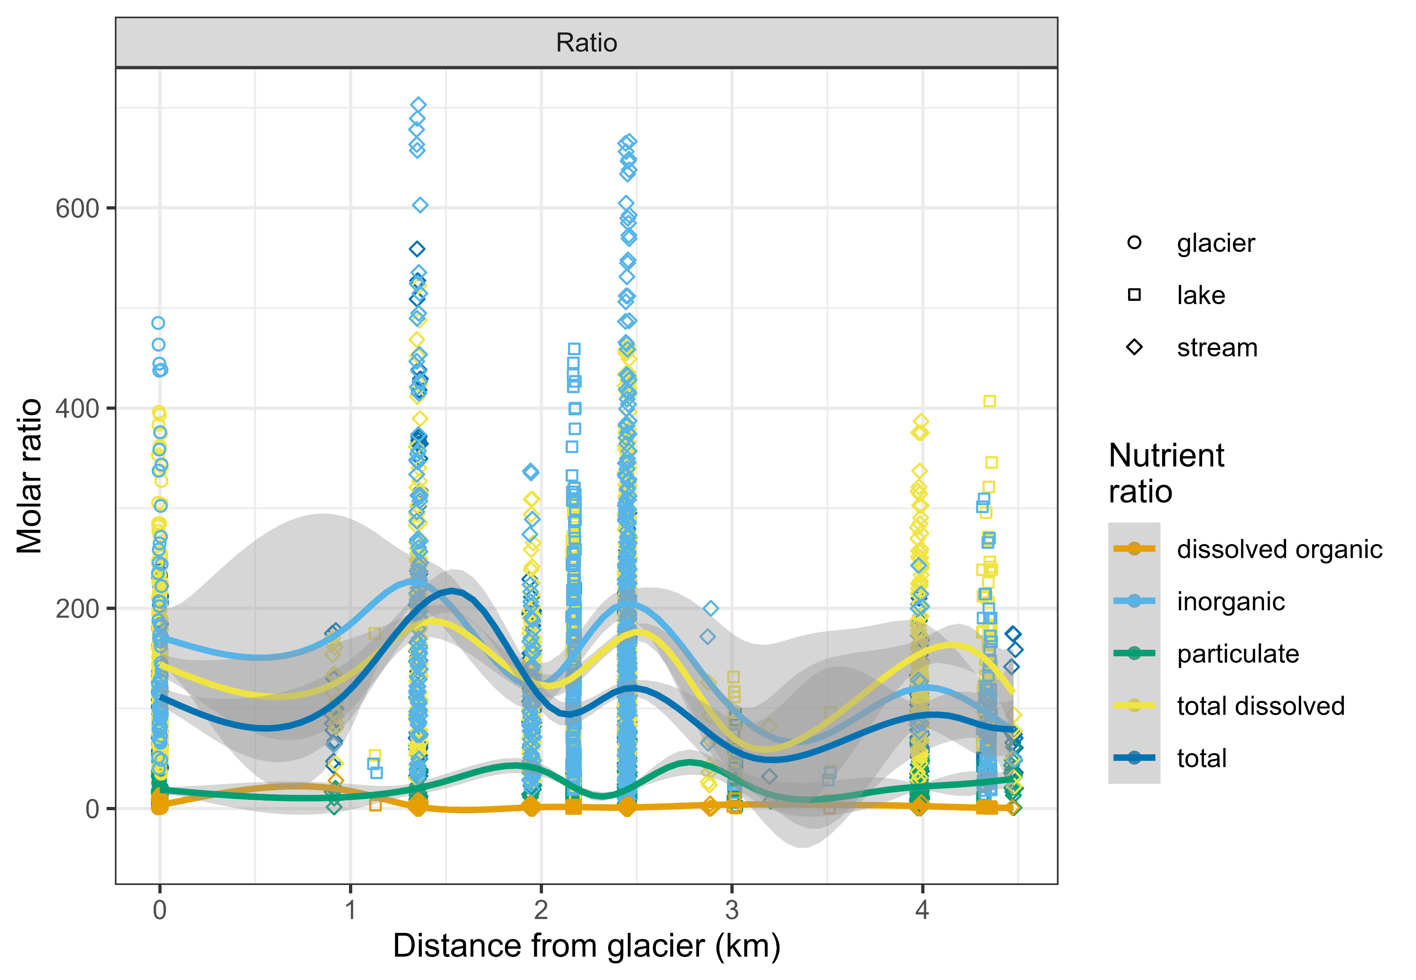
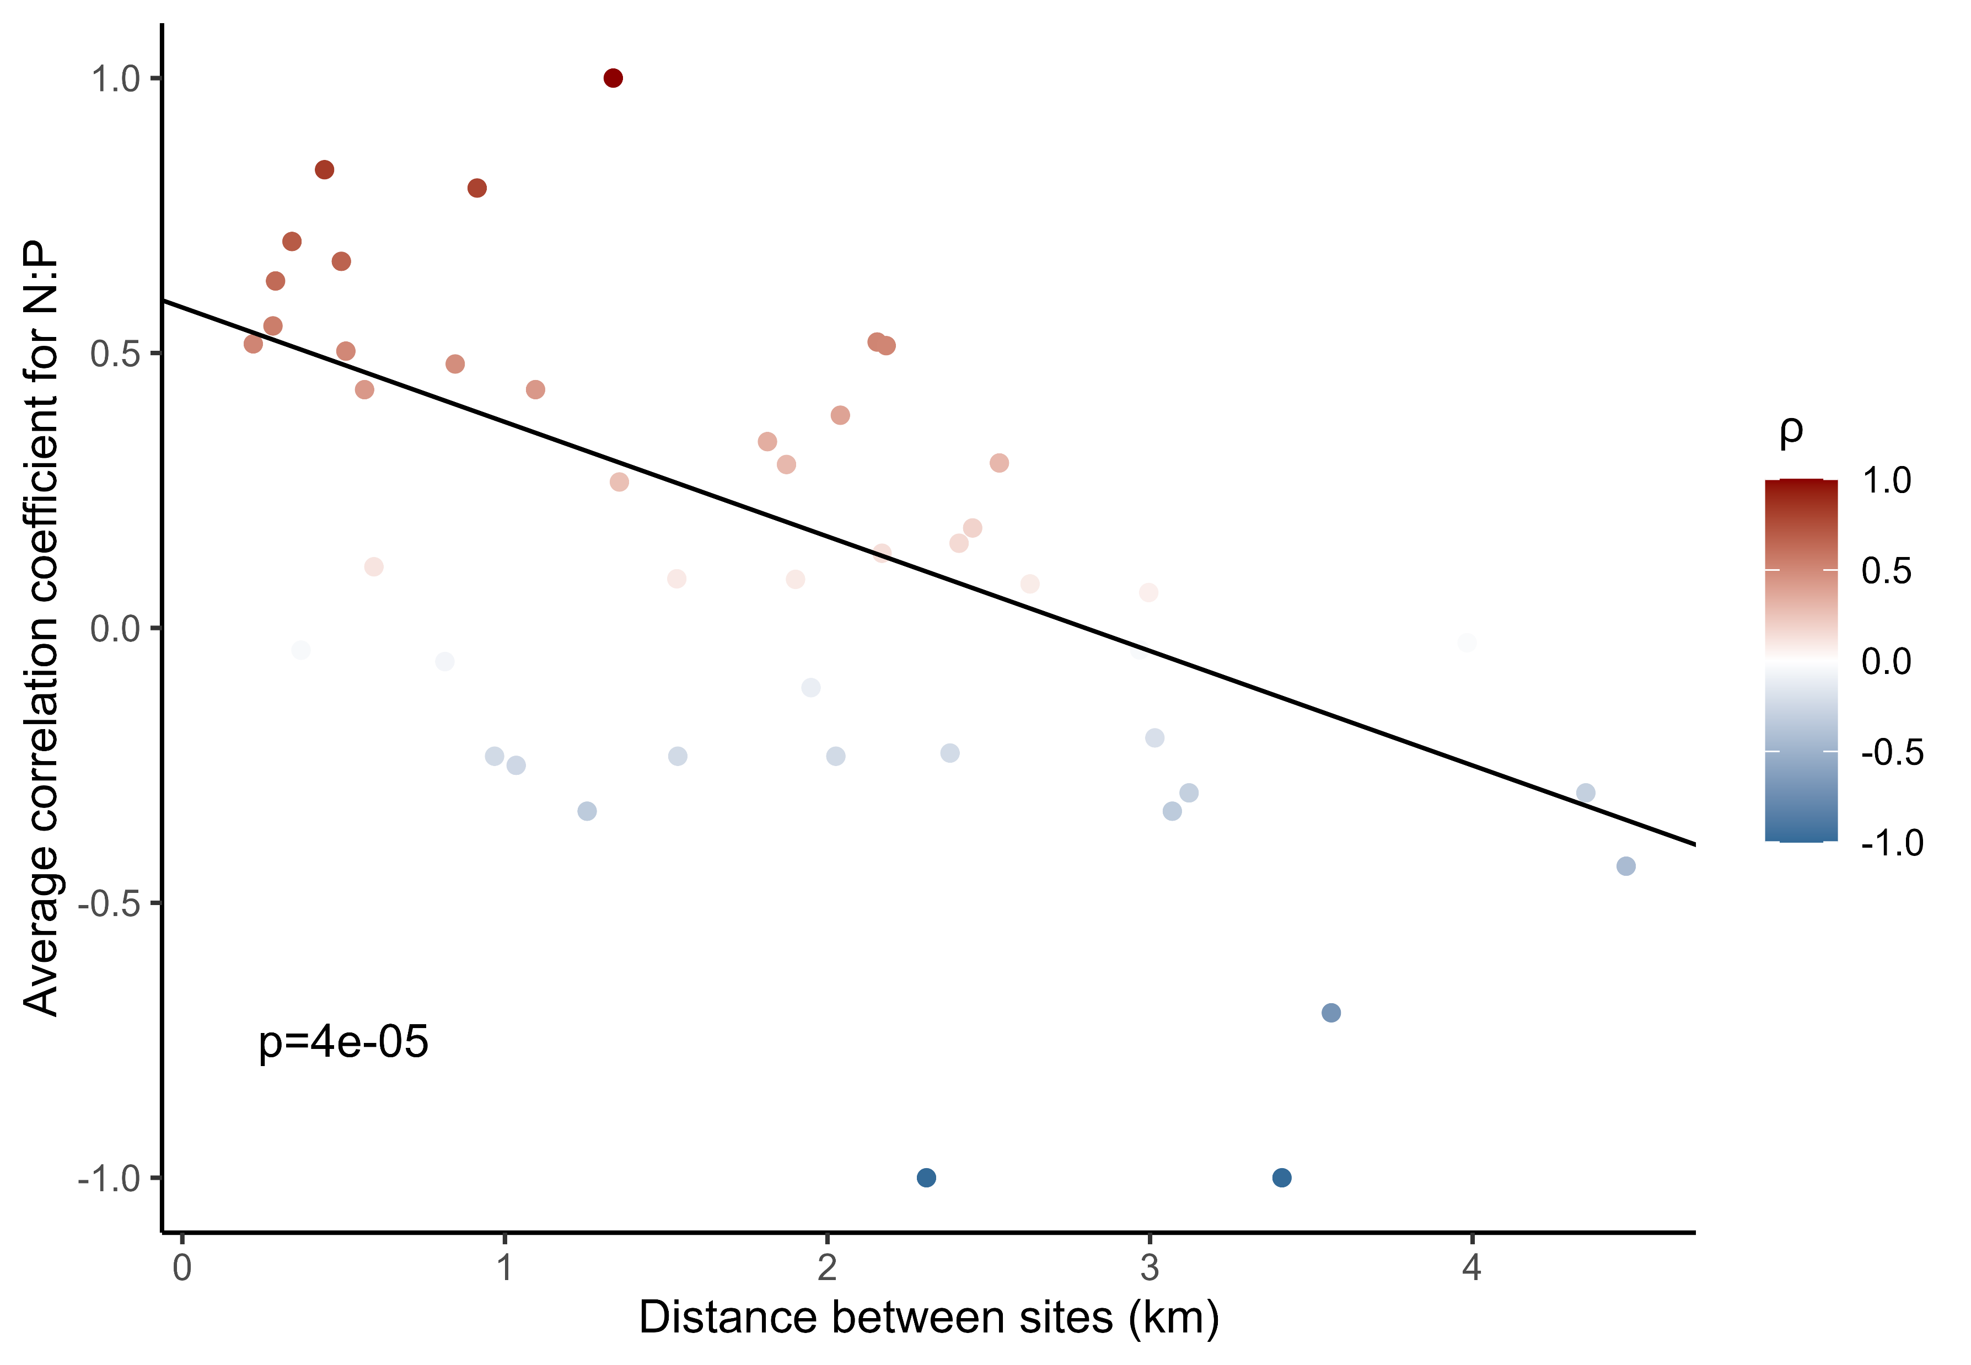
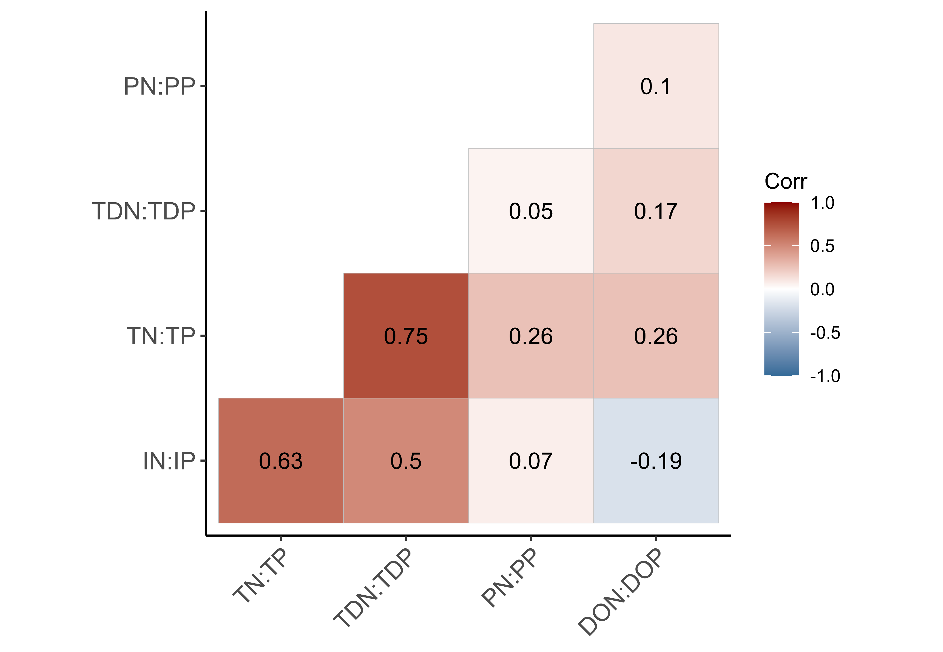
a)
b)
c)

Slide 7
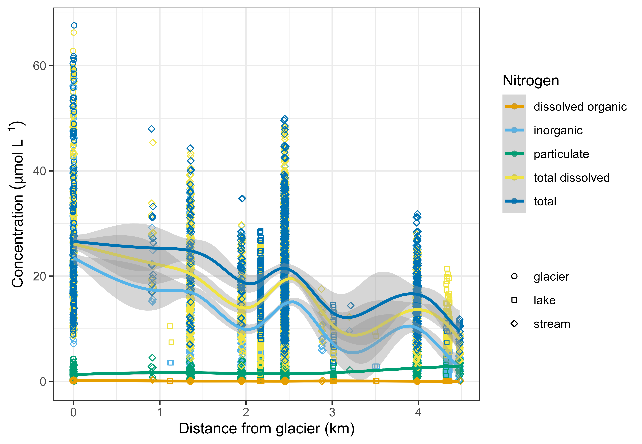
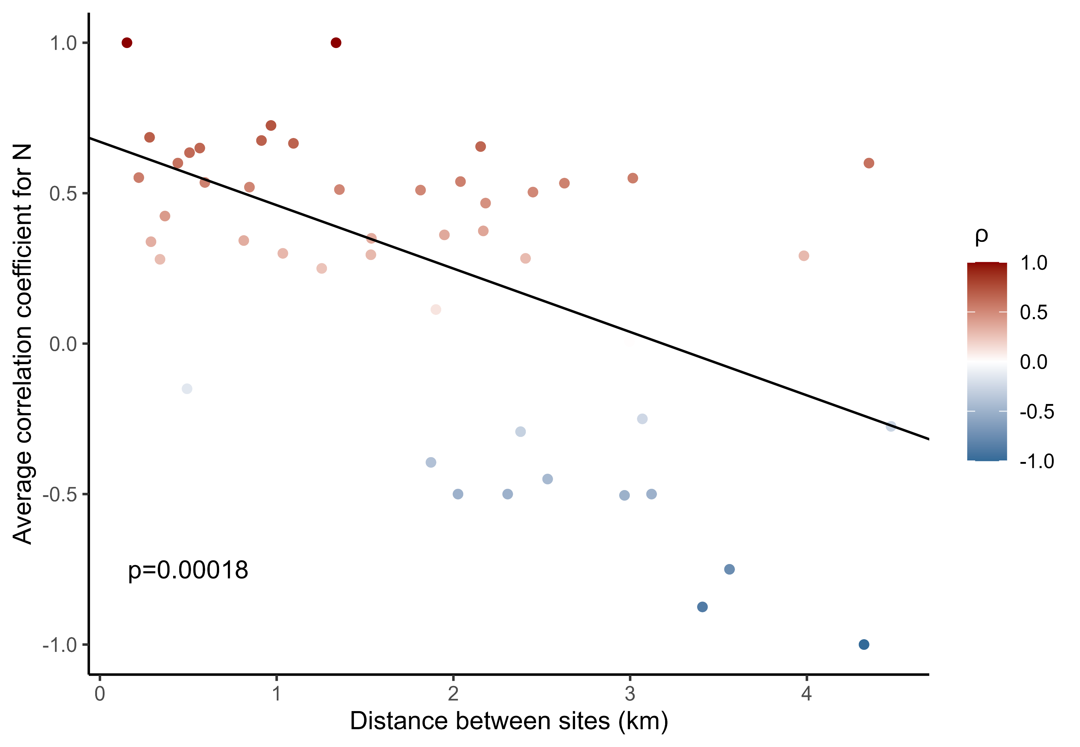
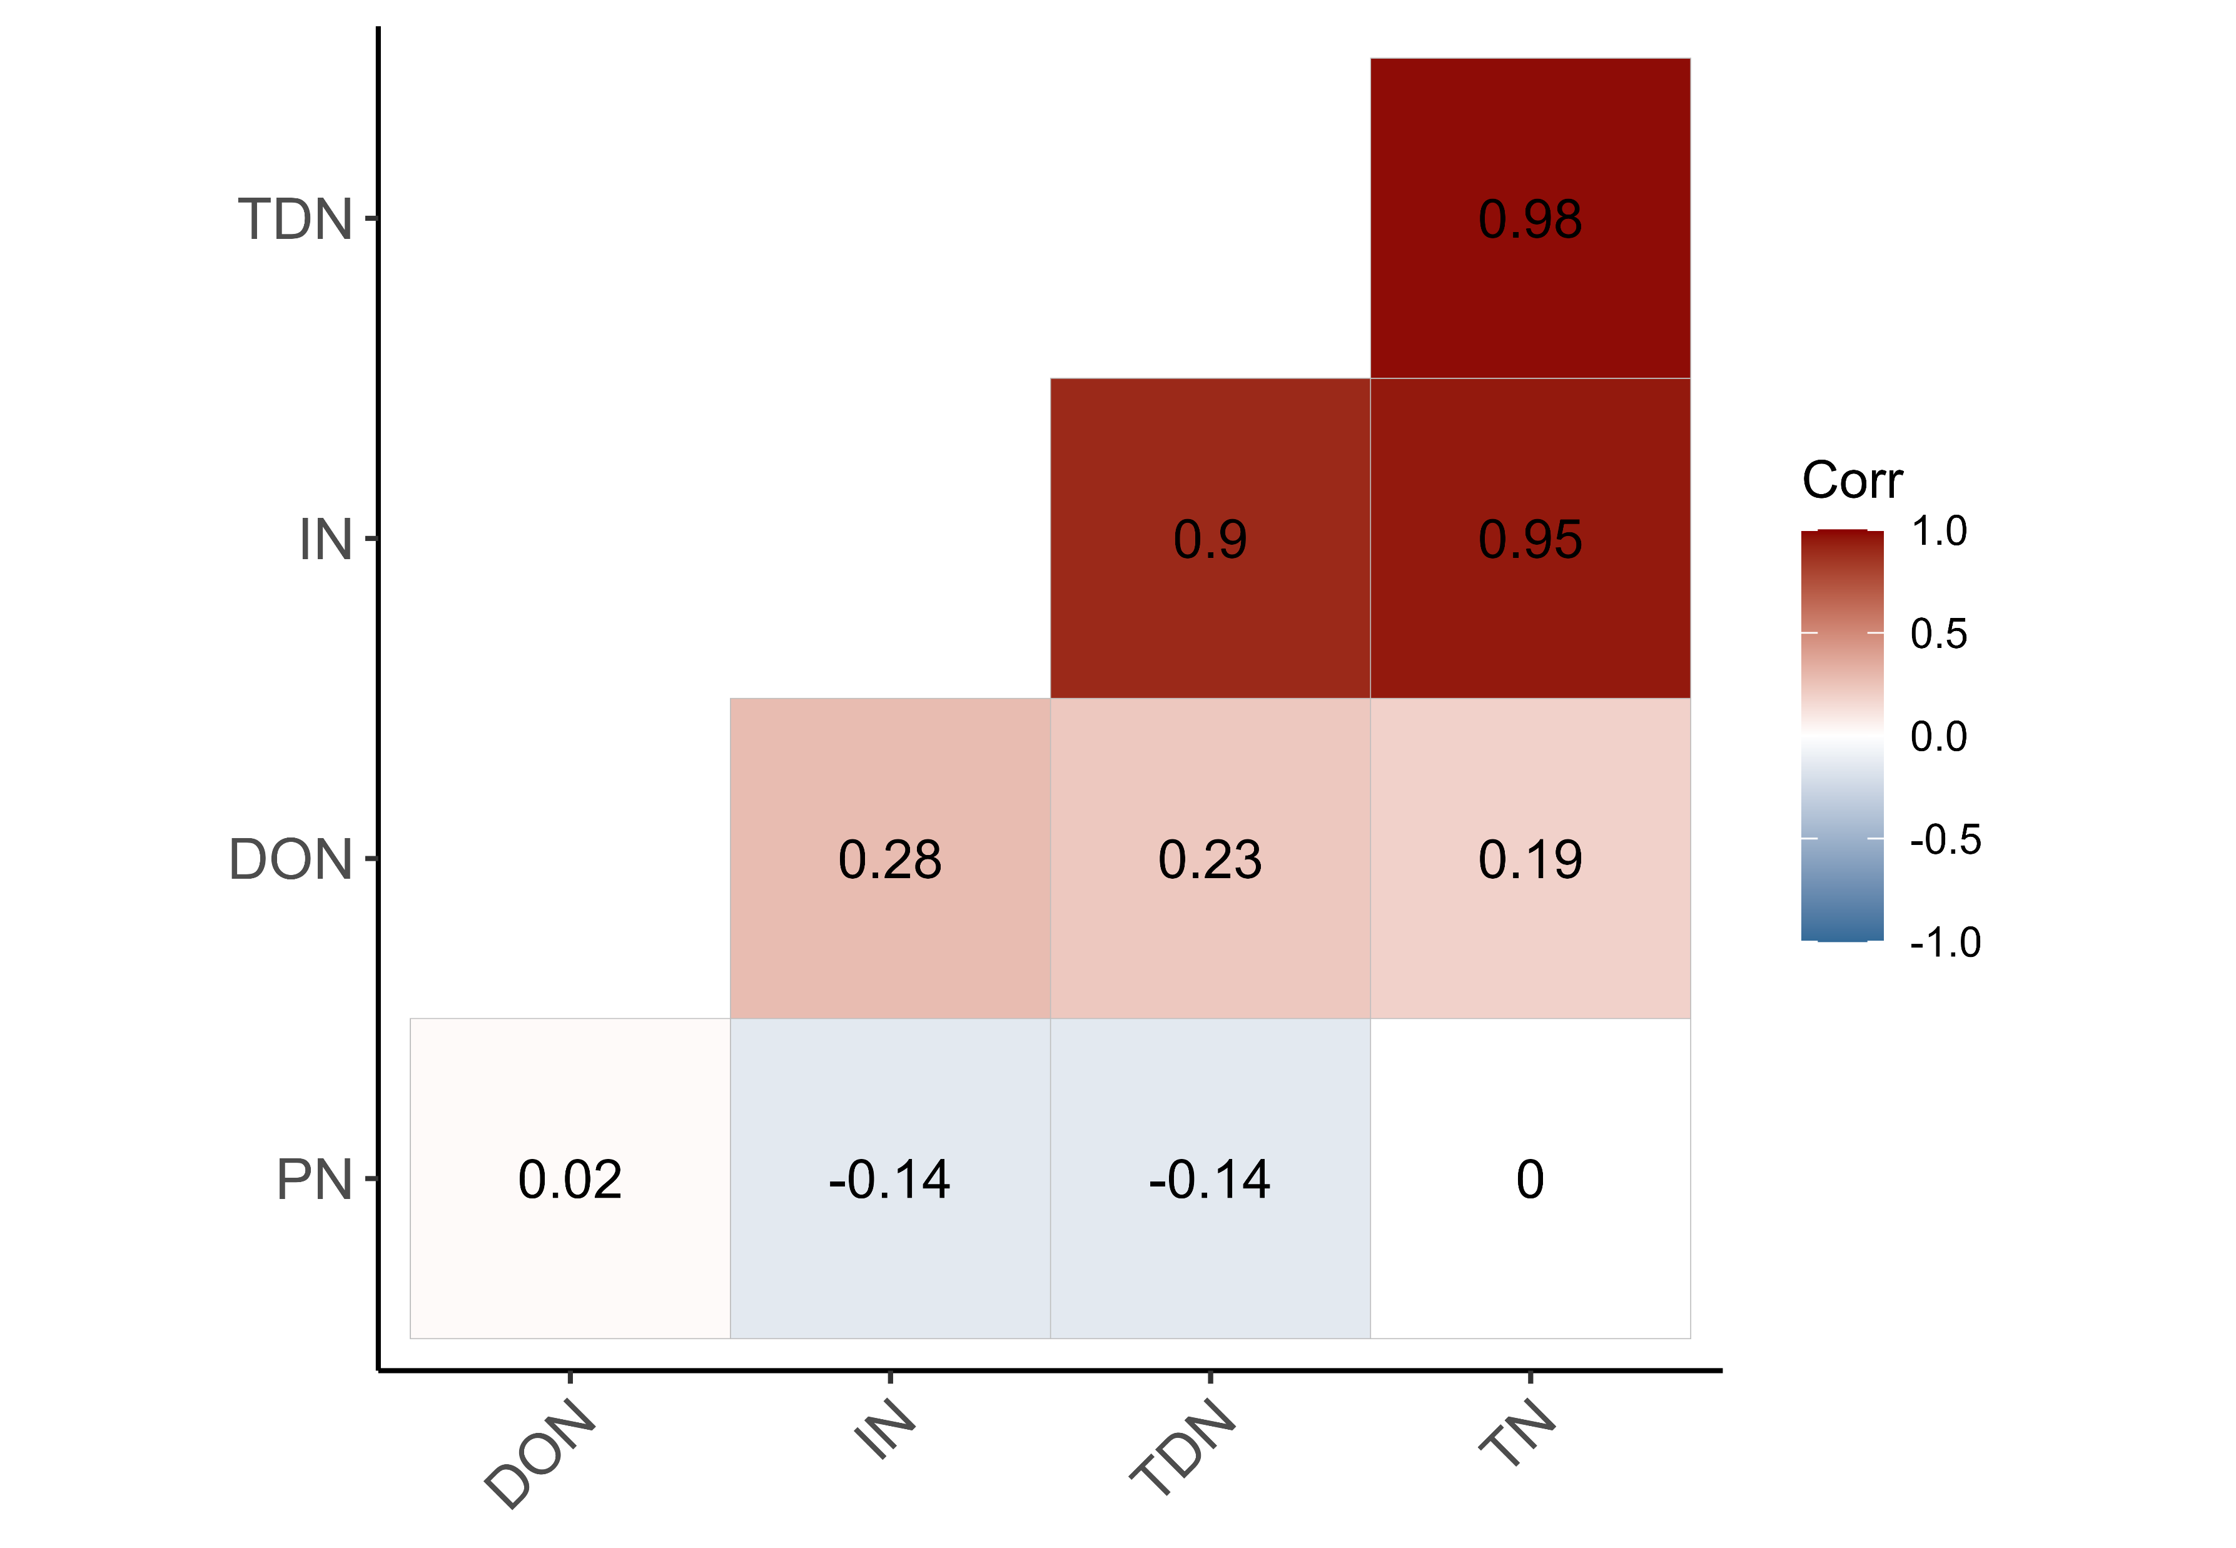
a)
b)
c)

Slide 8
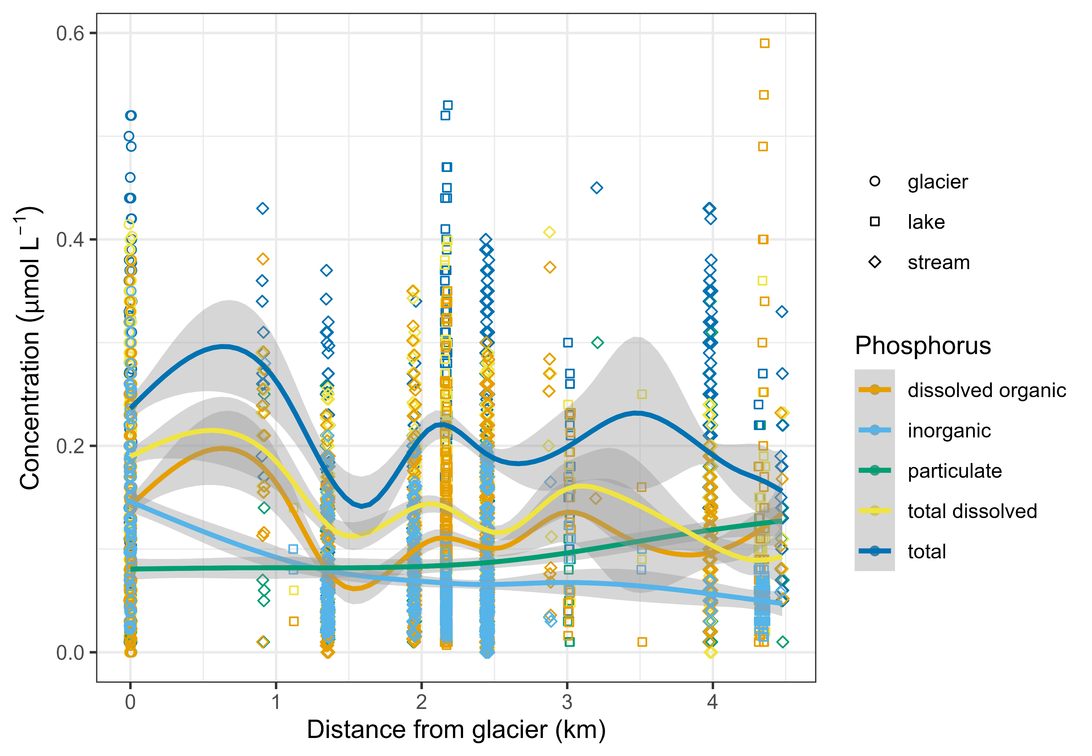
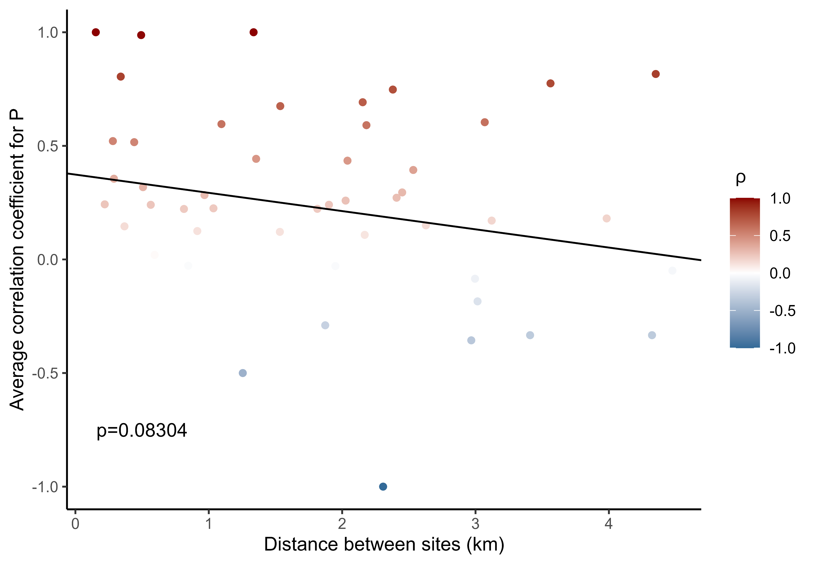
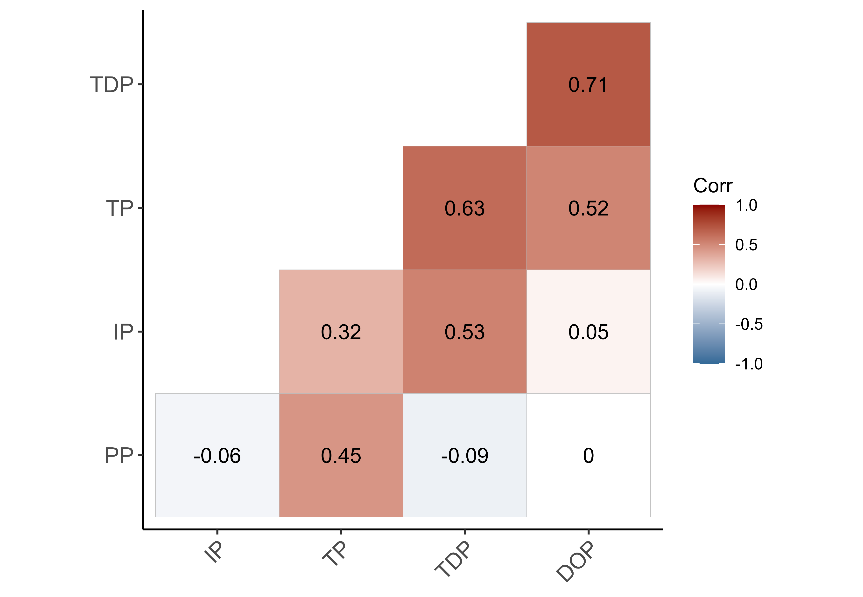
a)
b)
c)

Slide 9
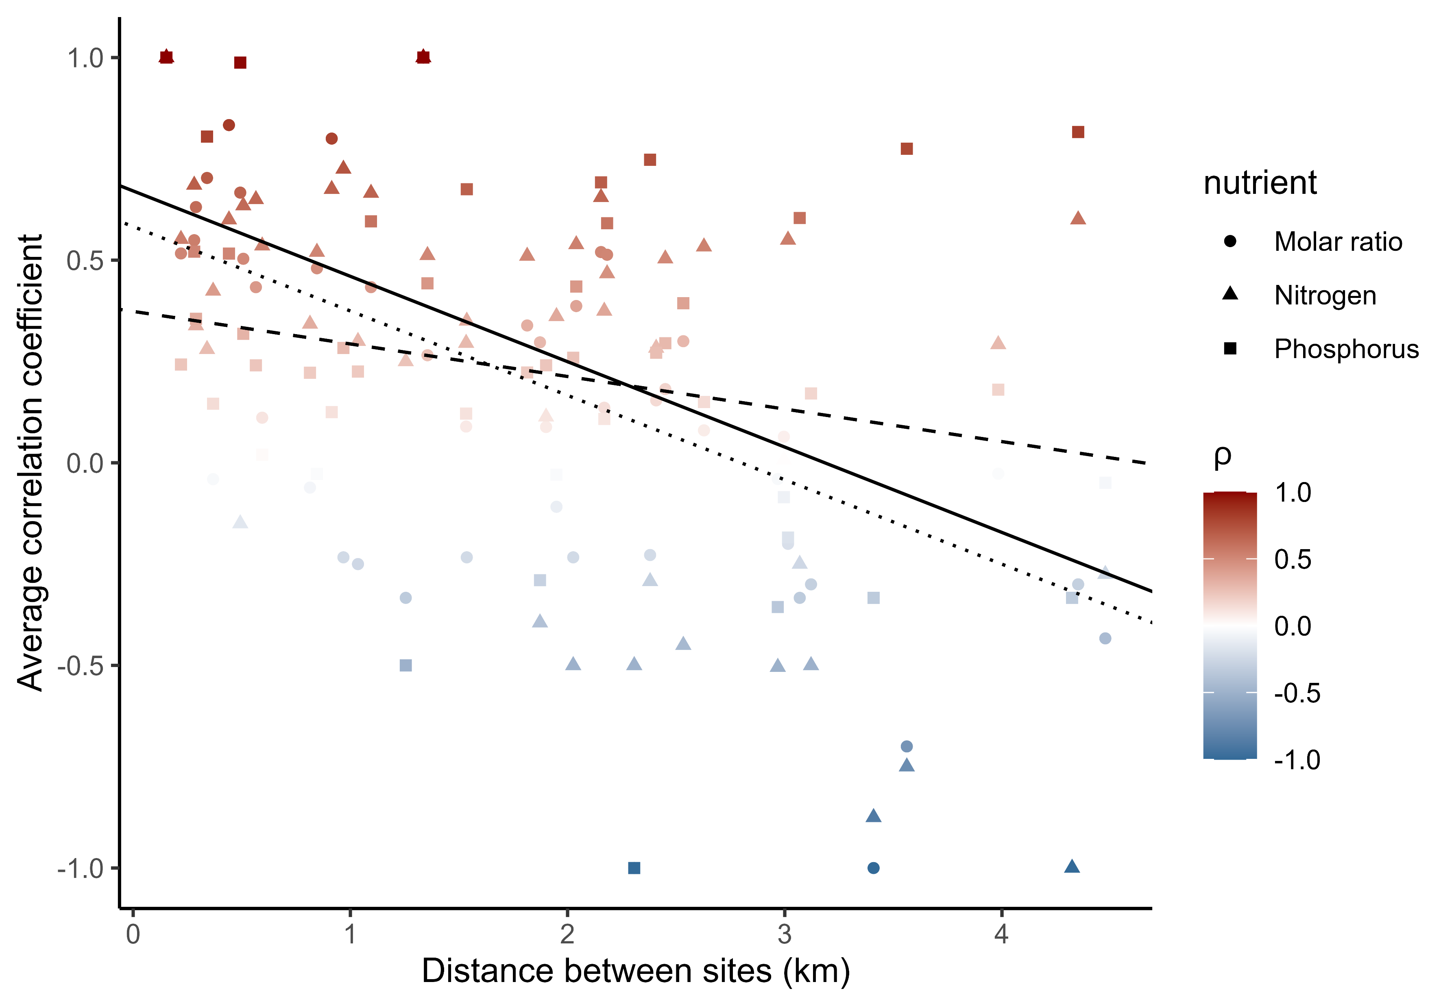
Molar ratio
Nitrogen
Phosphorus

Slide 10
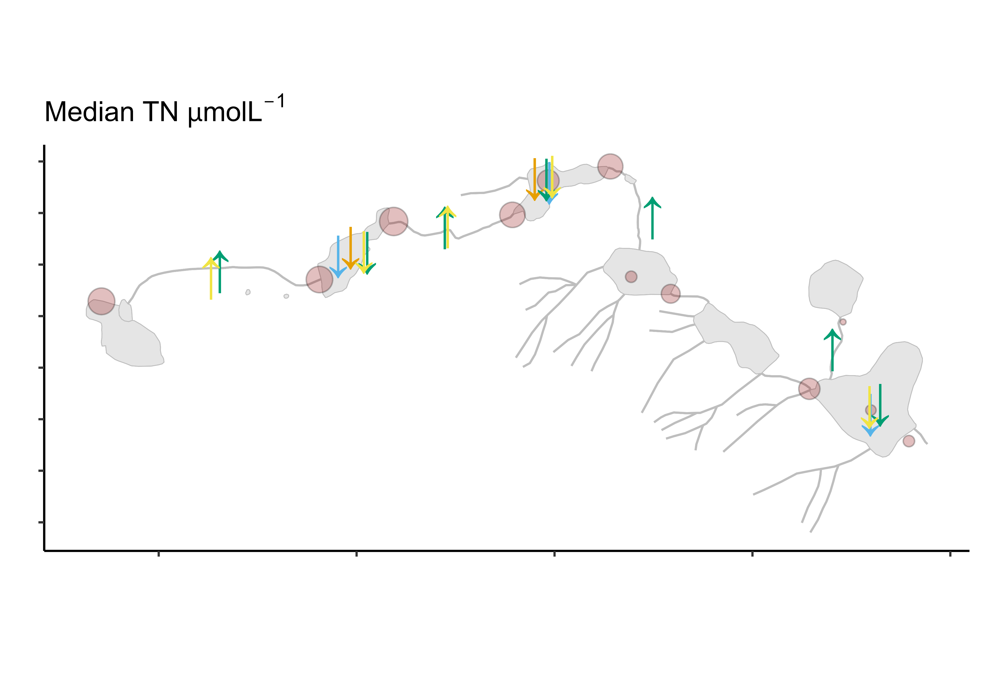
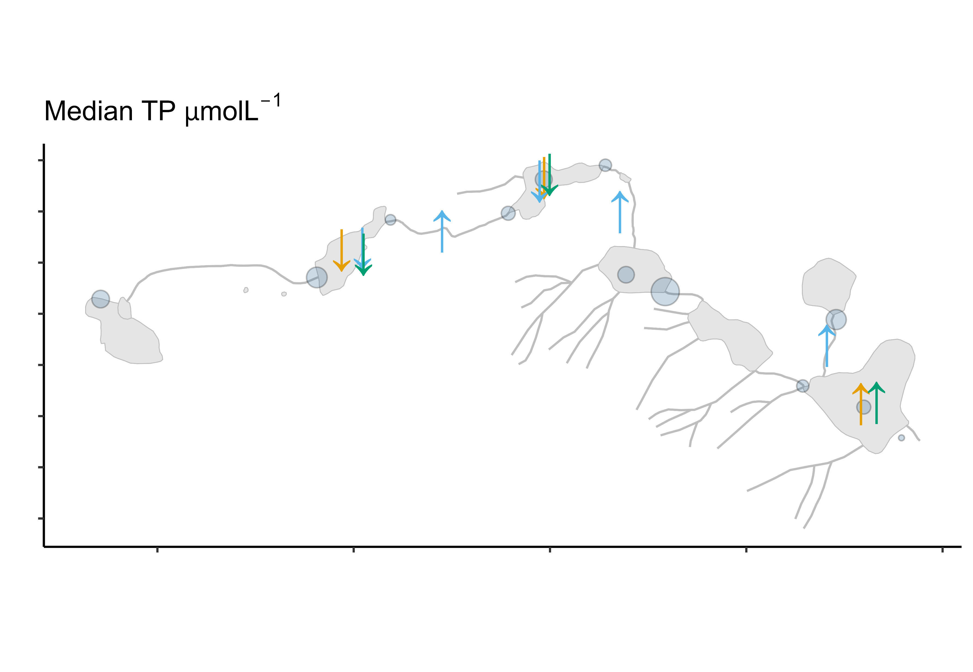
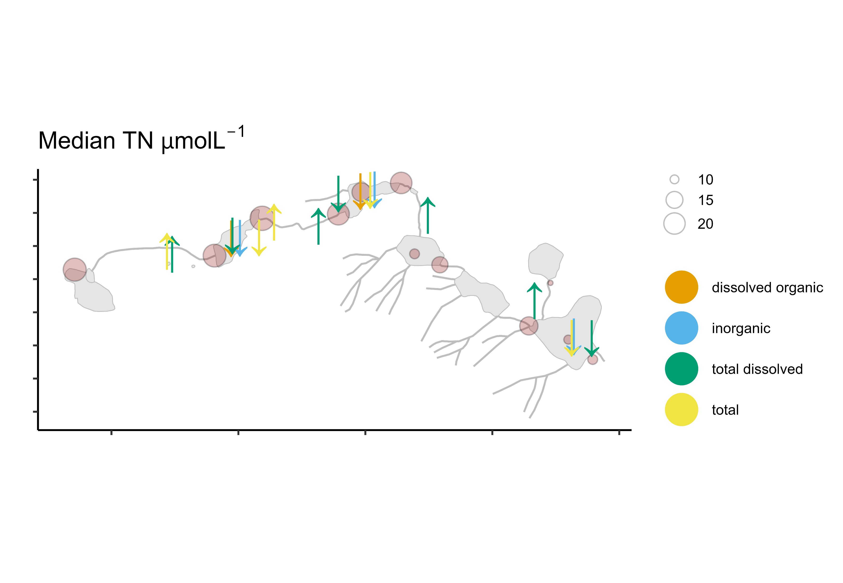
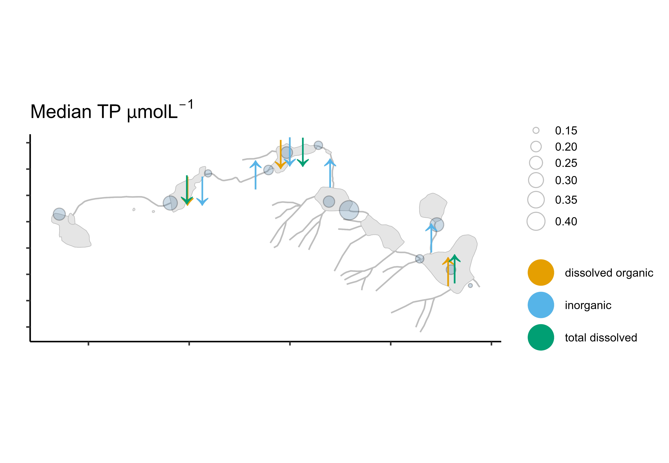
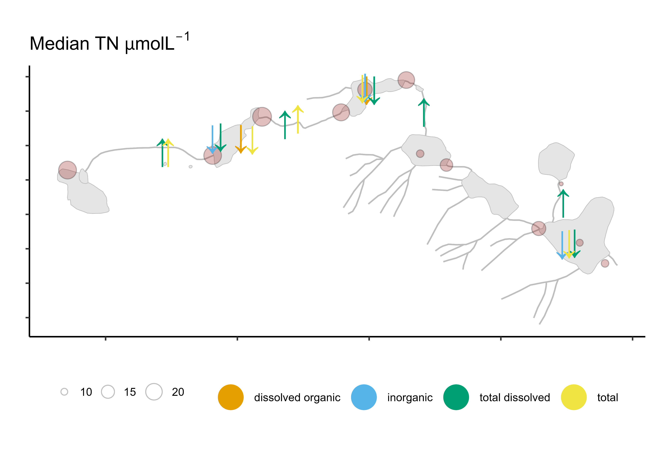

Slide 11
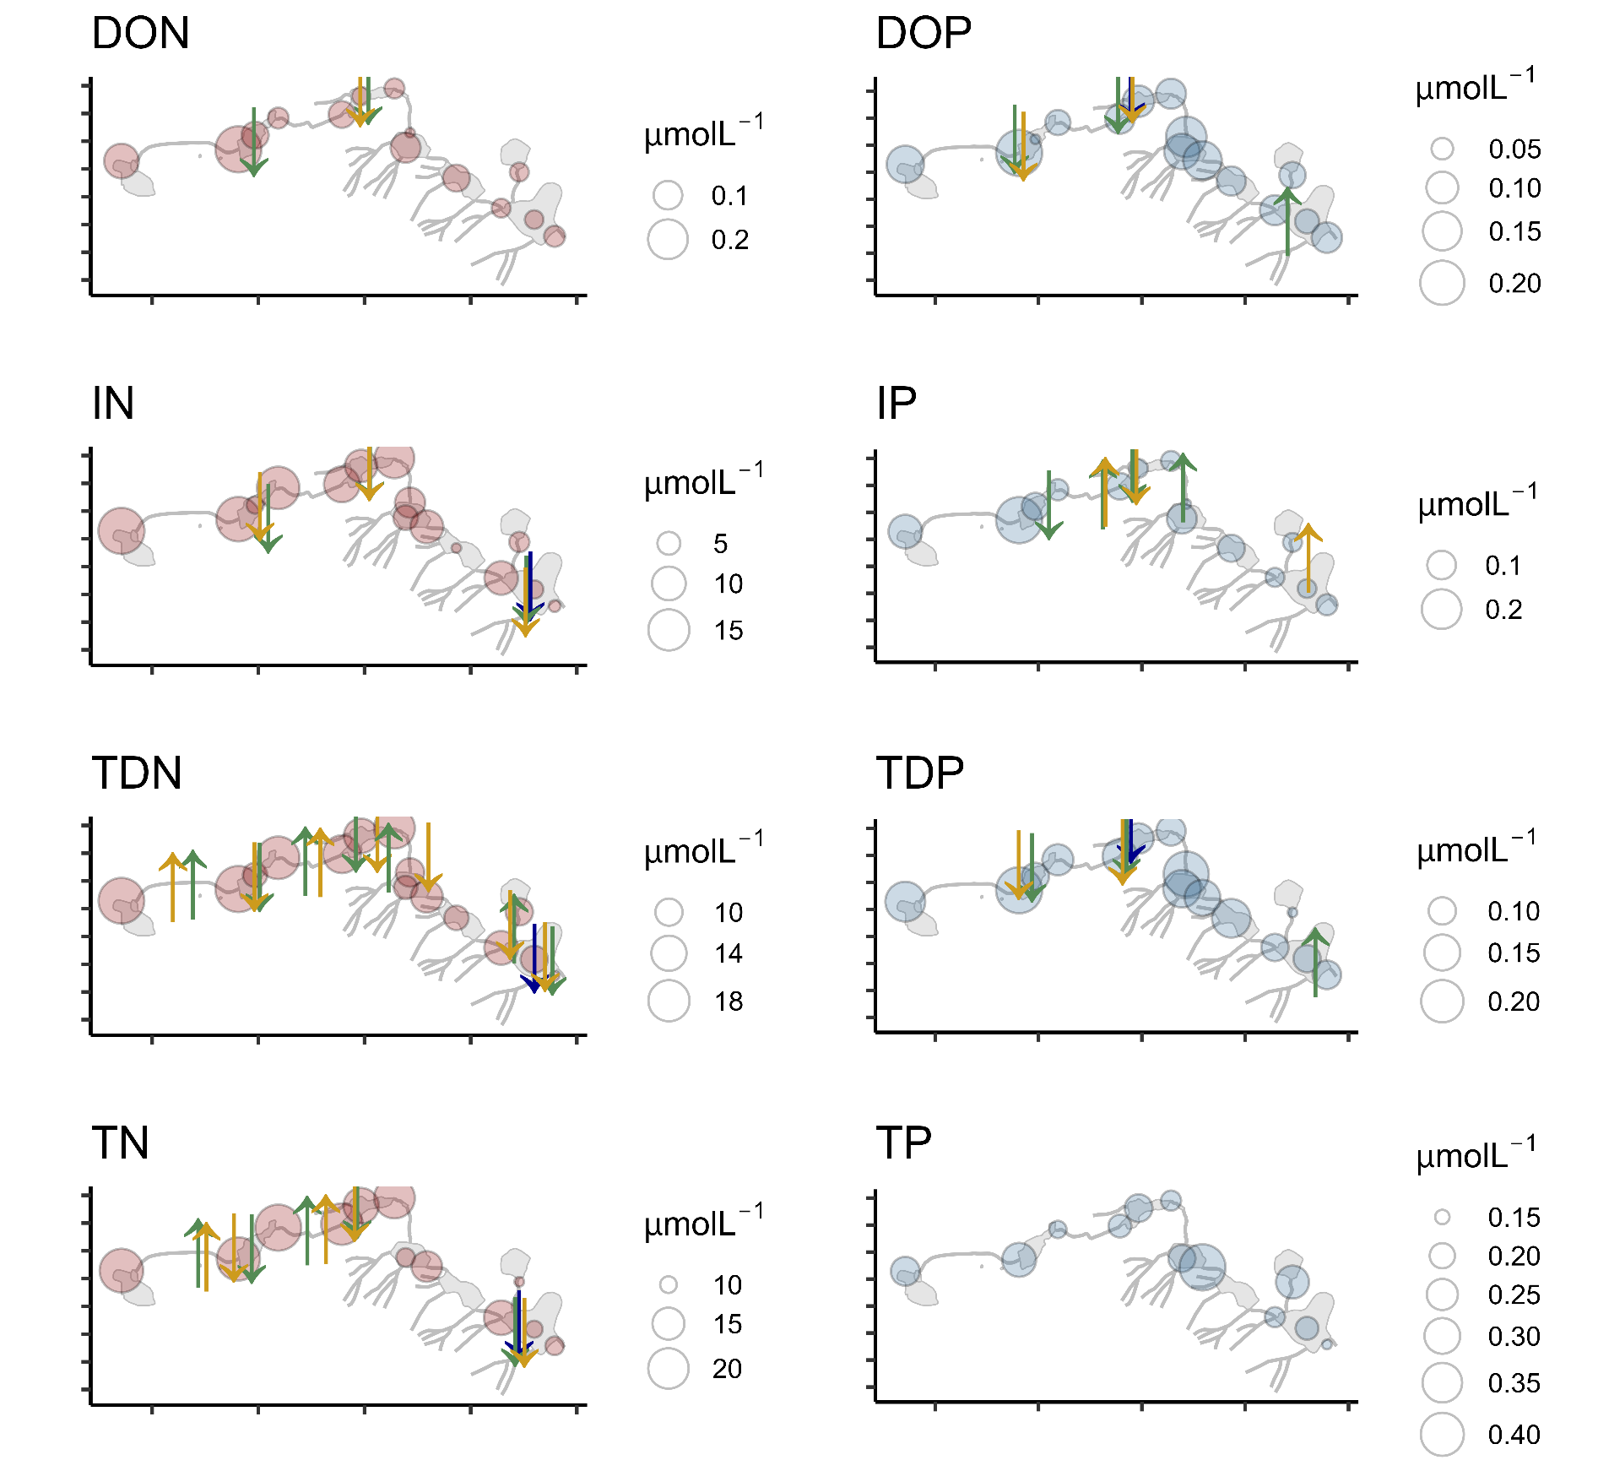
winter
snowmelt runoff
summer

Slide 12
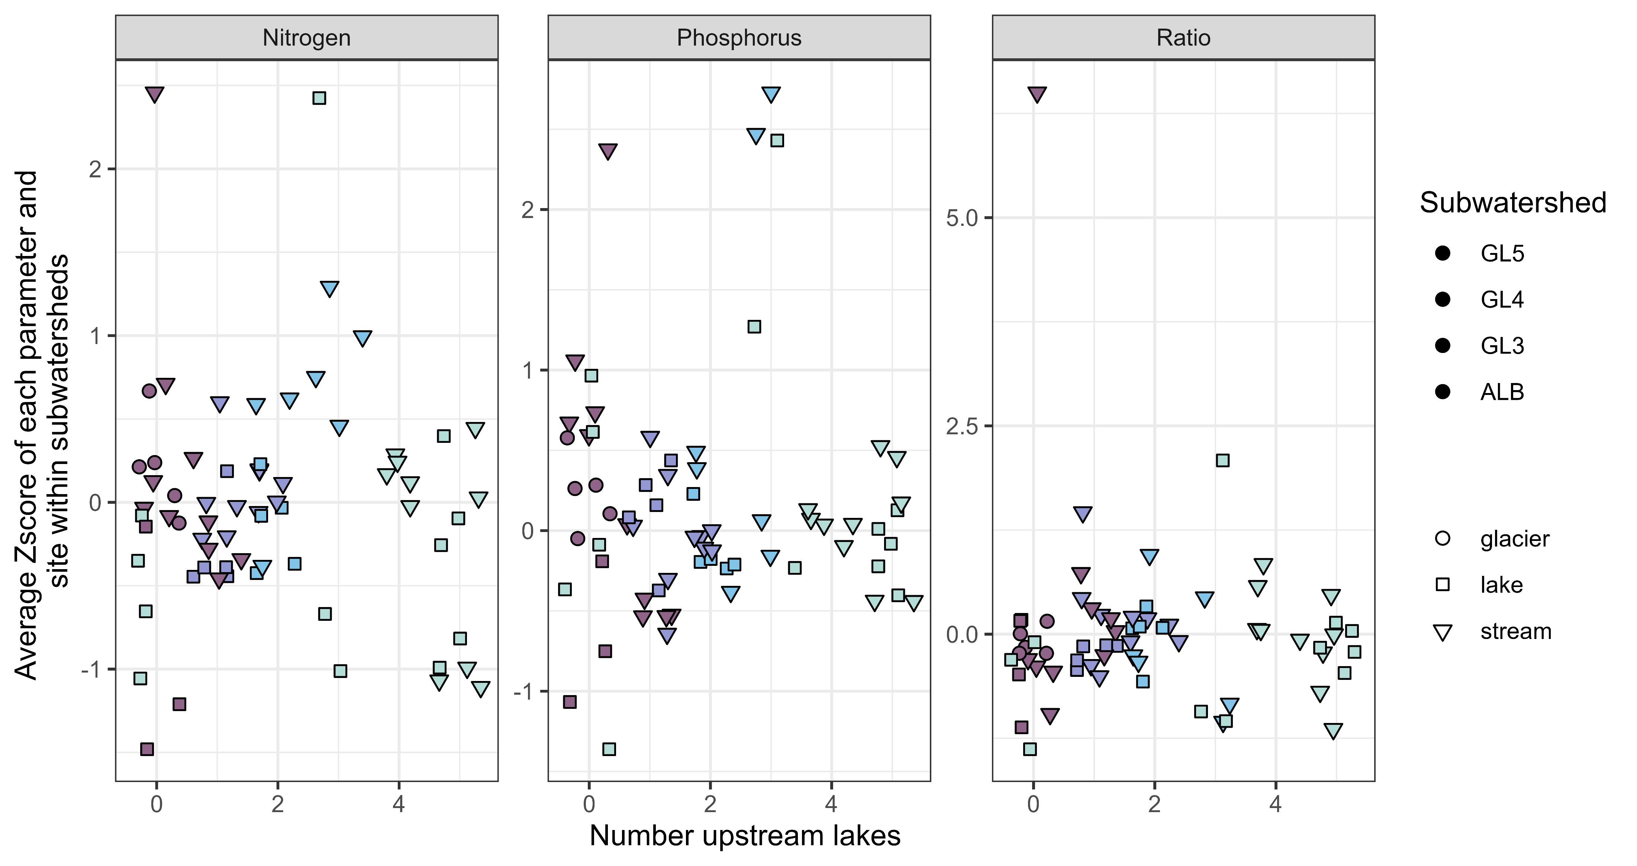


Slide 13
